Slide 1
Procedural Terrain Generation

Slide 2
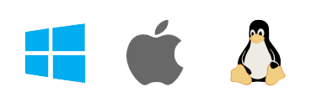
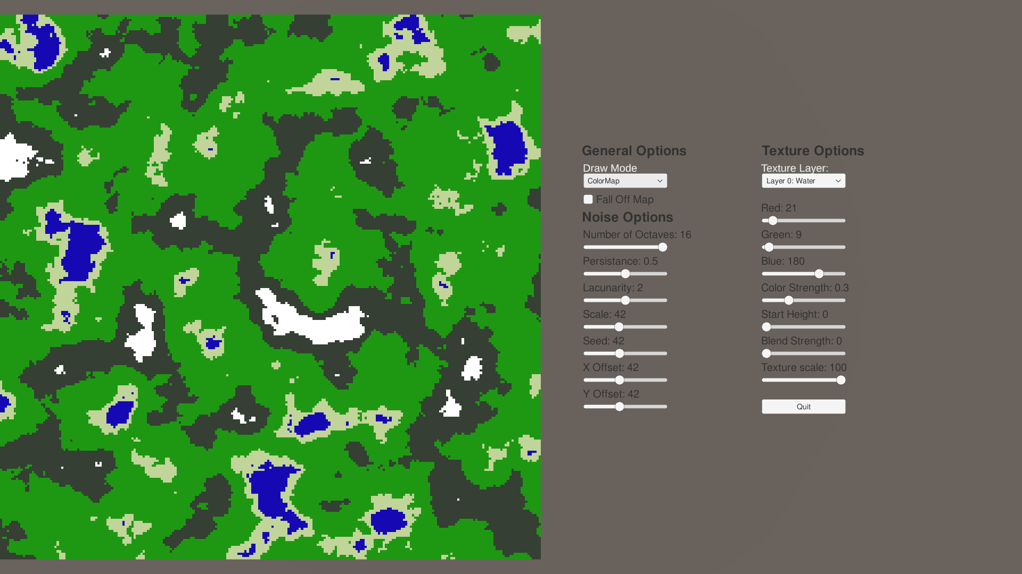

Project Demo
Desktop Application
Noise Map
Color Map
Mesh
Generate Controlled Procedural Terrain
Noise Settings
Mesh Settings
Texture Settings

Slide 3
1
Noise Settings

Slide 4
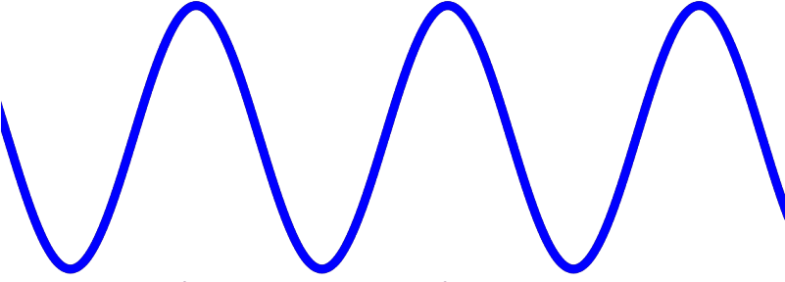
Noise Settings: Perlin Noise
Number of Octaves Layers of noise
Lacunarity Increase of frequency per layer
Persistance Decrease of amplitude per layer
Amplitud
(Influence)
Frequency
(Detail)

Slide 5
2
Mesh Settings

Slide 6
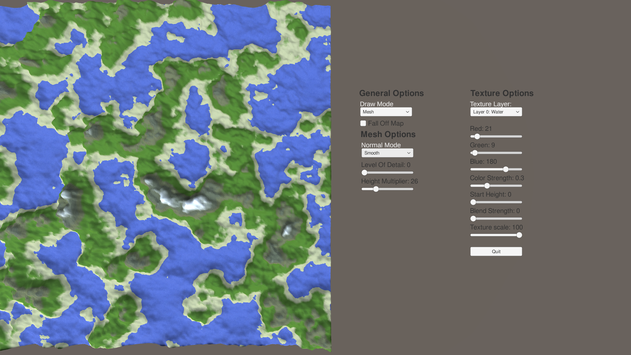
Mesh Settings
Normal Mode
Smooth Normals
Flat Normals
Height Multiplier
Level of Detail

Slide 7
3
Texture Settings

Slide 8
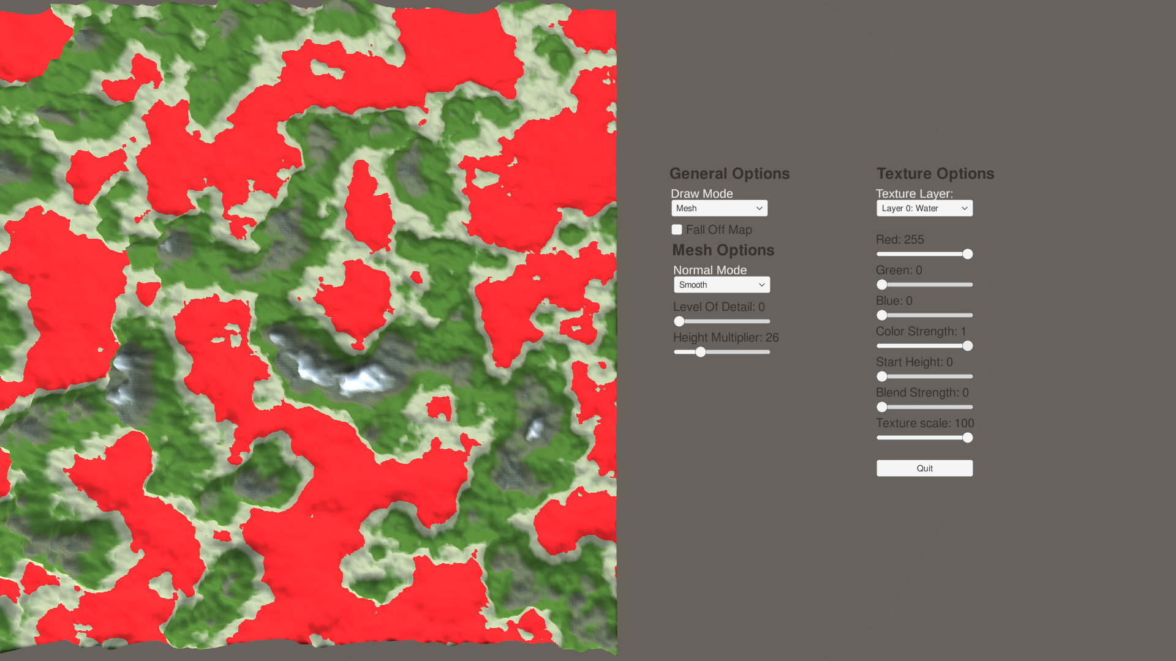
Texture Settings
Layered System
Start Height
Color
Color Strength
Blend Strength
Texture

Slide 9


Slide 10
Thanks!
ANY QUESTIONS?
You can find me at:
campos72@purdue.edu

